Slide 1
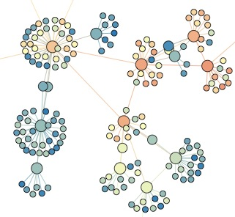

SNA 2A: ER graphs: Insights and realism
Lada Adamic

Slide 2
Insights
Previously: degree distribution / absence of hubs
Emergence of giant component
Average shortest path

Slide 3
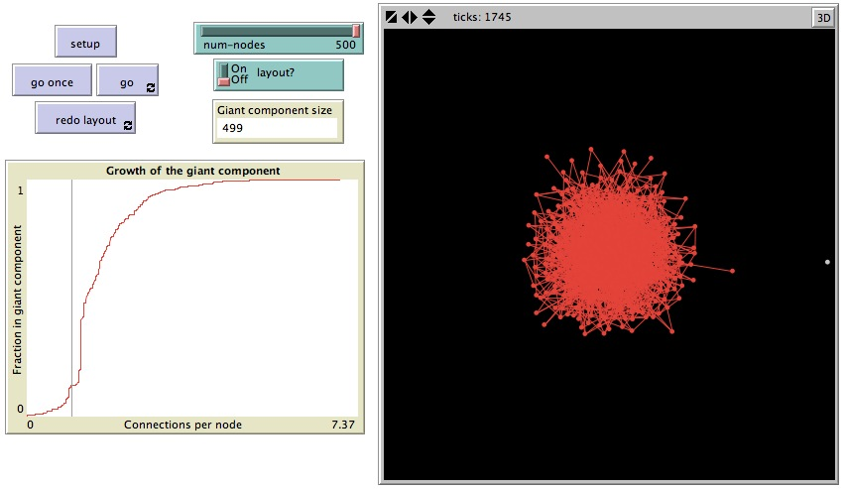
Emergence of the giant component
http://ccl.northwestern.edu/netlogo/models/GiantComponent

Slide 4
Quiz Q:
What is the average degree z at which the giant component starts to emerge?
0
1
3/2
3

Slide 5
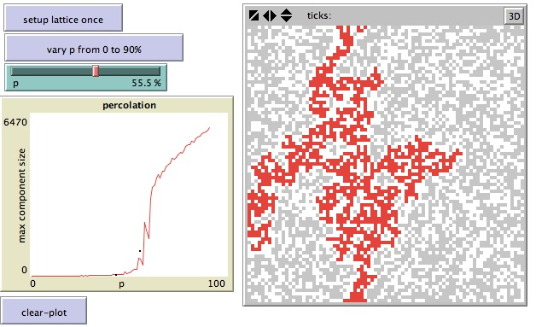
Percolation on a 2D lattice
http://www.ladamic.com/netlearn/NetLogo501/LatticePercolation.html

Slide 6
Quiz Q:
What is the percolation threshold of a 2D lattice: fraction of sites that need to be occupied in order for a giant connected component to emerge?
0
¼
1/3
1/2

Slide 7
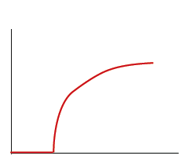
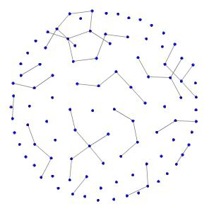
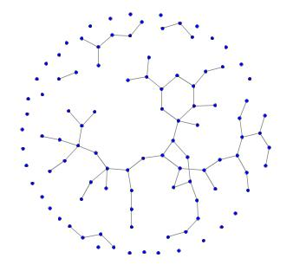
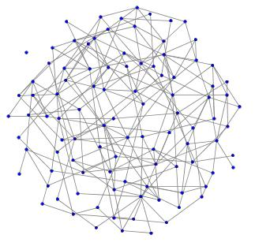
Percolation threshold
Percolation threshold: how many edges need to be added before the giant component appears?
As the average degree increases to z = 1, a giant component suddenly appears
size of giant component
average degree
av deg = 0.99
av deg = 1.18
av deg = 3.96

Slide 8
Giant component – another angle
How many other friends besides you does each of your friends have?
By property of degree distribution
the average degree of your friends, you excluded, is z
so at z = 1, each of your friends is expected to have another friend, who in turn have another friend, etc.
the giant component emerges

Slide 9
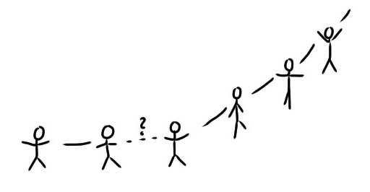
Giant component illustrated

Slide 10
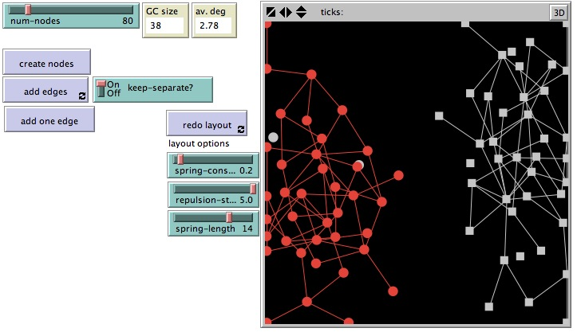
Why just one giant component?
What if you had 2, how long could they be sustained as the network densifies?
http://www.ladamic.com/netlearn/NetLogo501/ErdosRenyiTwoComponents.html

Slide 11
Quiz Q:
If you have 2 large-components each occupying roughly 1/2 of the graph, how long does it typically take for the addition of random edges to join them into one giant component
1-4 edge additions
5-20 edge additions
over 20 edge additions

Slide 12
Average shortest path
How many hops on average between each pair of nodes?
again, each of your friends has z = avg. degree friends besides you
ignoring loops, the number of people you have at distance l is z^{l}

Slide 13
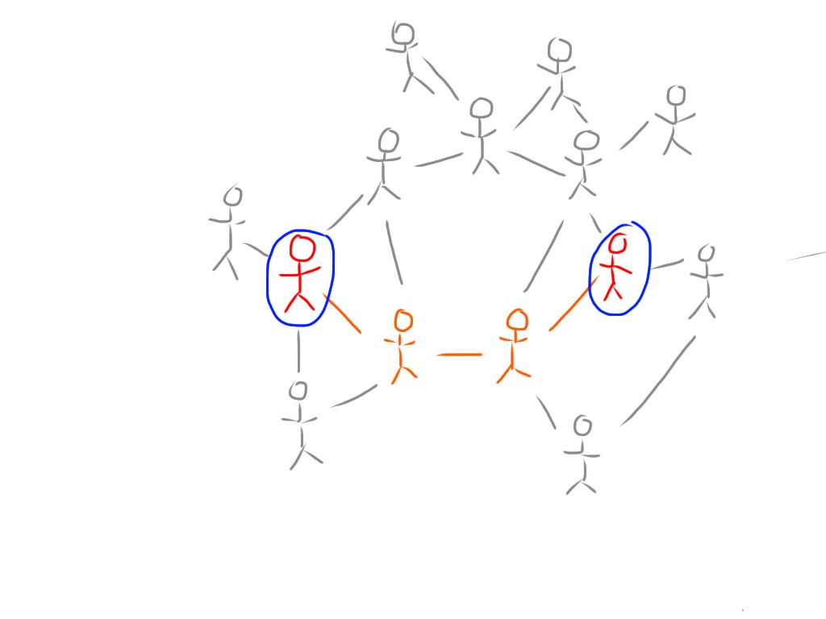
Average shortest path

Slide 14
friends at distance l
N_{l}=z^{l}
scaling:
average shortest path l_{av}

Slide 15
What this means in practice
Erdös-Renyi networks can grow to be very large but nodes will be just a few hops apart

Slide 16
Logarithmic axes
powers of a number will be uniformly spaced
1
2
3
10
20
30
100
200
2⁰=1, 2¹=2, 2²=4, 2³=8, 2⁴=16, 2⁵=32, 2⁶=64,….

Slide 17
Erdös-Renyi avg. shortest path

Slide 18
Quiz Q:
If the size of an Erdös-Renyi network increases 100 fold (e.g. from 100 to 10,000 nodes), how will the average shortest path change
it will be 100 times as long
it will be 10 times as long
it will be twice as long
it will be the same
it will be 1/2 as long

Slide 19
Realism
Consider alternative mechanisms of constructing a network that are also fairly “random”.
How do they stack up against Erdös-Renyi?
http://www.ladamic.com/netlearn/nw/RandomGraphs.html

Slide 20
Introduction model
Prob-link is the p (probability of any two nodes sharing an edge) that we are used to
But, with probability prob-intro the other node is selected among one of our friends’ friends and not completely at random

Slide 21
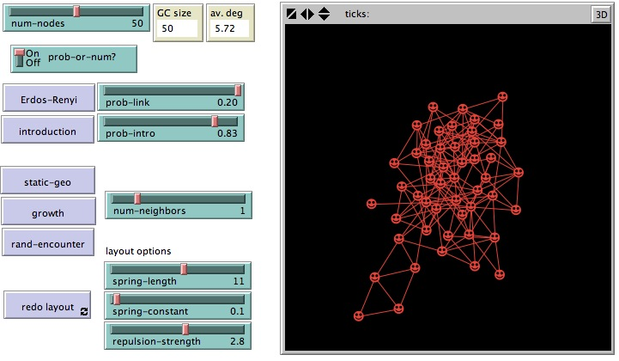
Introduction model

Slide 22
Quiz Q:
Relative to ER, the introduction model has:
more edges
more closed triads
longer average shortest path
more uneven degree
smaller giant component at low p

Slide 23
Static Geographical model
Each node connects to num-neighbors of its closest neighbors
use the num-neighbors slider, and for comparison, switch PROB-OR-NUM to ‘off’ to have the ER model aim for num-neighbors as well
turn off the layout algorithm while this is running, you can apply it at the end

Slide 24
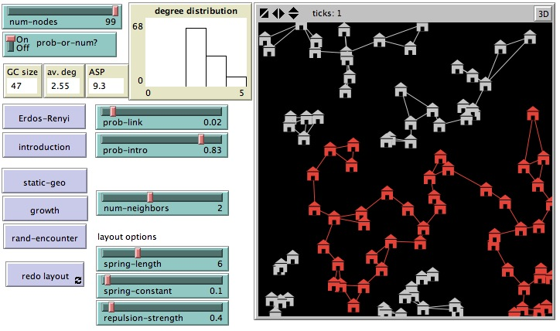
static geo

Slide 25
Quiz Q:
Relative to ER, the static geographical model has :
longer average shortest path
shorter average shortest path
narrower degree distribution
broader degree distribution
smaller giant component at a low number of neighbors
larger giant component at a low number of neighbors

Slide 26
Random encounter
People move around randomly and connect to people they bump into
use the num-neighbors slider, and for comparison, switch PROB-OR-NUM to ‘off’ to have the ER model aim for num-neighbors as well
turn off the layout algorithm while this is running (you can apply it at the end)

Slide 27
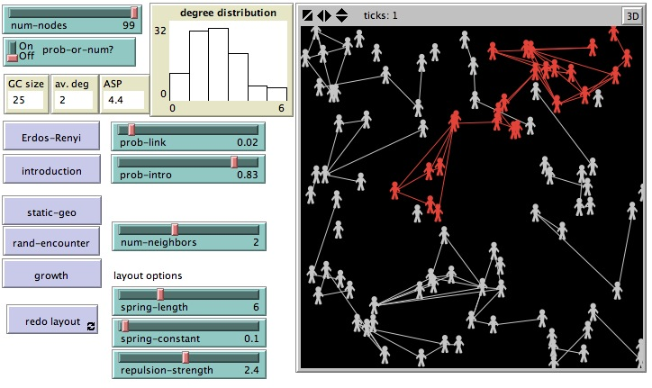
random encounters

Slide 28
Quiz Q:
Relative to ER, the random encounters model has :
more closed triads
fewer closed triads
smaller giant component at a low number of neighbors
larger giant component at a low number of neighbors

Slide 29
Growth model
Instead of starting out with a fixed number of nodes, nodes are added over time
use the num-neighbors slider, and for comparison, switch PROB-OR-NUM to ‘off’ to have the ER model aim for num-neighbors as well

Slide 30
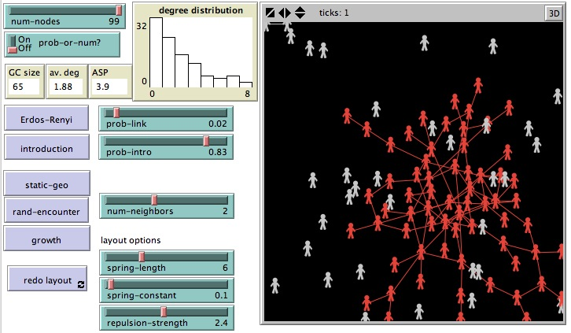
growth model

Slide 31
Quiz Q:
Relative to ER, the growth model has :
more hubs
fewer hubs
smaller giant component at a low number of neighbors
larger giant component at a low number of neighbors

Slide 32
other models
in some instances the ER model is plausible
if dynamics are different, ER model may be a poor fit

